Slide 1

PyTorch Fundamentals
PREPARED BY
PRESENTED TO
Ahmed Saleh Almutairi
Dr. Safwan Alsewi

Slide 2
01 | FRAMEWORK OVERVIEW
What is PyTorch?
PyTorch is a Python based framework for tensor computation and building and training neural networks.
SIMPLE DEFINITION
Think of PyTorch as an AI toolbox
• Tensor: the number container PyTorch uses for data.
• nn.Module: the building system used to define a neural network.
• Autograd + Optimizer: the tools that calculate gradients and update the model.
The PyTorch learning workflow
DATA
MODEL
WHY PEOPLE USE IT
One workflow from experiment to training
• Python-friendly: models are written with normal Python code.
• Hardware-aware: the same tensor operations can run on CPU or supported accelerators.
• Flexible: you can inspect values and change model logic while developing.
LOSS
BACKWARD
UPDATE
Main idea
PyTorch connects data, a model, error measurement, and learning.
JRCAI | Joint Research Center for AI (SDAIA - KFUPM) • PyTorch Fundamentals
02 / 18

Slide 3
02 | MINI PROJECT
Our Example: Study Hours → Exam Score
We will use regression model throughout the presentation, so every concept has a purpose.
THE PROBLEM
Predict one number from another
• Input / feature: how many hours a student studied.
• Target: the exam score we want the model to learn.
• Regression: predicting a continuous number, such as a score or price.
What the model will learn
7 hours
INPUT
Tiny Neural
Network
MODEL
≈ 92
PREDICTION
Study Hours | Exam Score
1 | 45
2 | 52
3 | 60
4 | 68
5 | 76
6 | 84
JRCAI | Joint Research Center for AI (SDAIA - KFUPM) • PyTorch Fundamentals
03 / 18

Slide 4
03 | CORE DATA STRUCTURE
Tensor: PyTorch’s Container for Numbers
A tensor is the general structure. Scalars, vectors, and matrices are simply tensors with different numbers of dimensions.
0D
1D
2D
3D+
Scalar
Vector
Matrix
Tensor
5
1
2
3
1
2
3
4
5.0
[1, 2, 3]
[[1,2], [3,4]]
stack of matrices
One number
A list of numbers
Rows × columns
More dimensions
Important
A vector is a 1D tensor and a matrix is a 2D tensor. “Tensor” is the general PyTorch word that covers all of them.
JRCAI | Joint Research Center for AI (SDAIA - KFUPM) • PyTorch Fundamentals
04 / 18

Slide 5
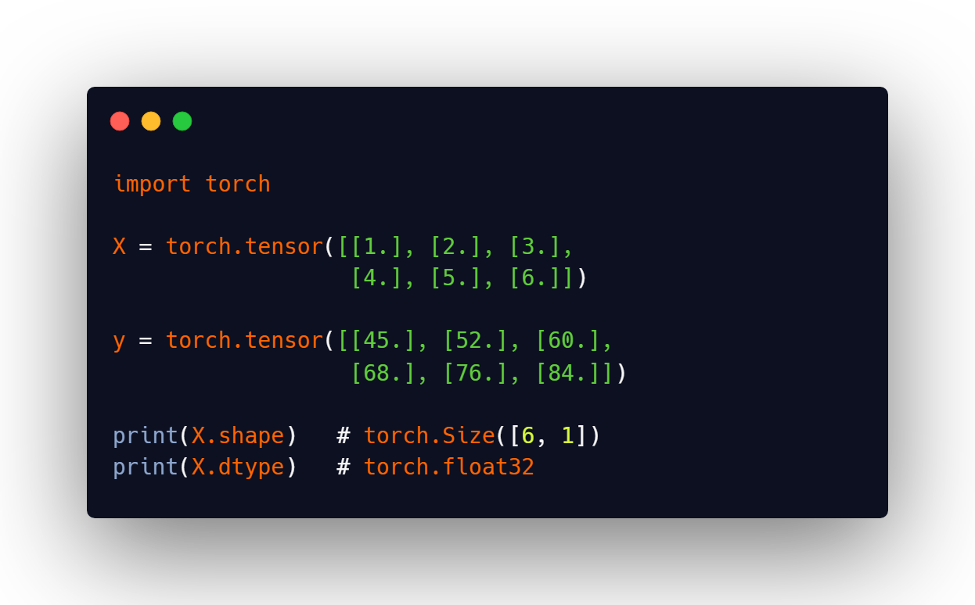
04 | TENSORS IN CODE
Our Training Data as PyTorch Tensors
Now we convert the study-hours examples and the real scores into tensors that PyTorch can work with.
SHAPE
What does [6, 1] mean?
• 6: six student examples.
• 1: one input feature per student: study hours.
DTYPE
What is float32?
• Data type: how each number is stored. Neural networks usually work with floating-point values.
DEVICE
Where does the tensor live?
• CPU / GPU: a tensor has a device. The model and its input tensors must be on compatible devices.
JRCAI | Joint Research Center for AI (SDAIA - KFUPM) • PyTorch Fundamentals
05 / 18

Slide 6
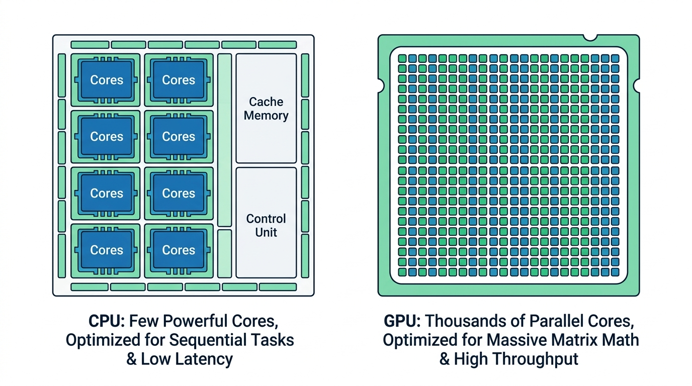
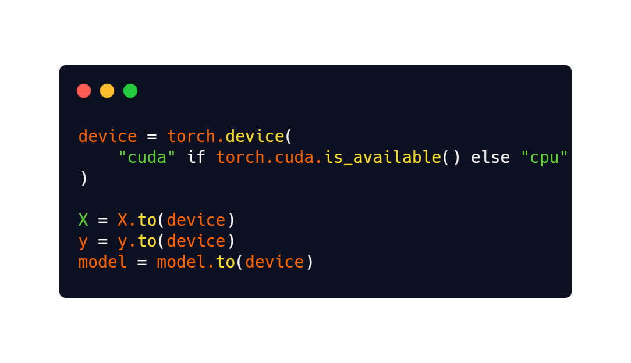
05 | HARDWARE
CPU, GPU, and the device Variable
A GPU can accelerate large tensor operations, but our tiny demo works perfectly on a CPU too.
CPU
Good general-purpose worker
• Think of it as: a few powerful workers handling many different tasks.
• For our demo: the CPU is more than enough.
GPU
Good parallel math worker
• Think of it as: many workers doing similar calculations at the same time.
• Useful when: models and batches become much larger.
JRCAI | Joint Research Center for AI (SDAIA - KFUPM) • PyTorch Fundamentals
06 / 18

Slide 7
06 | DATA
Features and Targets: What Are X and y?
Machine learning data is usually split into the information we give the model and the answer we want it to learn.
INPUT
Feature (X)
• Feature: a piece of information used to make a prediction.
• In our model: X contains study hours: 1, 2, 3, 4, 5, 6.
One training example
5 hours
76 score
Feature X
Target y
ANSWER
Target (y)
• Target: the correct value the model should learn to predict.
• In our model: y contains the real exam scores.
What is the model trying to learn?
A relationship between X and y. During training, the model changes its internal weights until its predictions become closer to the targets.
JRCAI | Joint Research Center for AI (SDAIA - KFUPM) • PyTorch Fundamentals
07 / 18

Slide 8
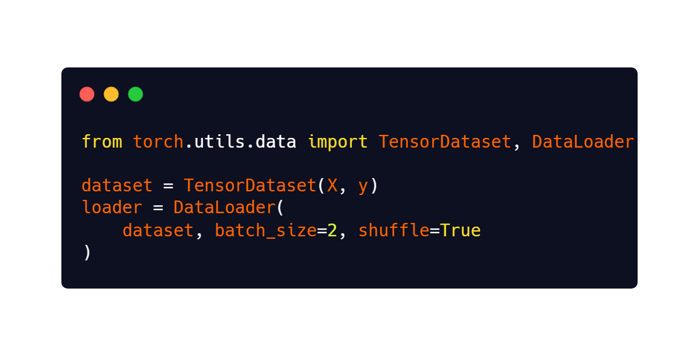
07 | DATA PIPELINE
Dataset vs. DataLoader
A Dataset stores/accesses examples. A DataLoader serves those examples in convenient mini-batches.
DATASET
The collection of examples
• Analogy: a bookshelf containing all training examples.
• Typical job: return one sample and its target when requested.
DATALOADER
The batch delivery system
• Analogy: a waiter bringing a few examples at a time.
• Can handle: batching, shuffling, and parallel data loading.
For our demo
We can train directly on the six tensors, so a DataLoader is optional here. In real projects, it becomes much more useful.
JRCAI | Joint Research Center for AI (SDAIA - KFUPM) • PyTorch Fundamentals
08 / 18

Slide 9
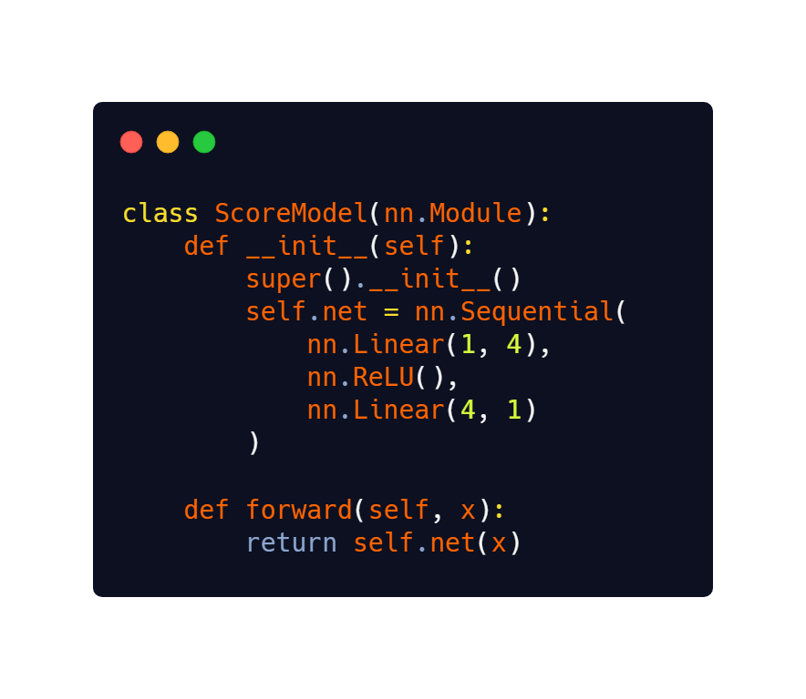
08 | MODEL ARCHITECTURE
Build the Neural Network with nn.Module
A model is a collection of layers. Each layer transforms the numbers and contains parameters the model can learn.
1 input
4 hidden
1 output
What do these words mean?
Layer: Processes the data.
Weight: A learnable value that changes during training.
ReLU: Adds non-linearity by replacing negative values with zero.
forward(): Defines how input travels through the network.
JRCAI | Joint Research Center for AI (SDAIA - KFUPM) • PyTorch Fundamentals
09 / 18

Slide 10
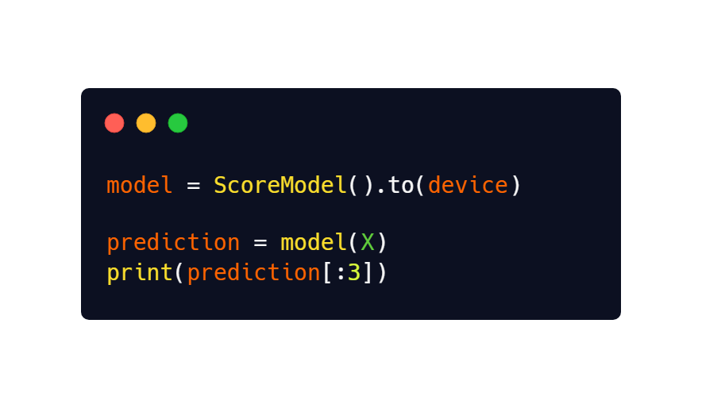
09 | FORWARD PASS
Forward Pass: Let the Model Make a Prediction
The forward pass means sending input through the network from the first layer to the output.
Data moves forward through the network
Study
Hours
Linear +
ReLU
Predicted
Score
IMPORTANT
A prediction is not learning yet
• Forward pass: produces an answer using the model’s current weights.
• Training starts when: we compare that answer with the target and calculate a loss.
At the beginning
The weights are mostly random, so the first predictions can be poor. That is normal, the next steps teach the model how to improve.
JRCAI | Joint Research Center for AI (SDAIA - KFUPM) • PyTorch Fundamentals
10 / 18

Slide 11
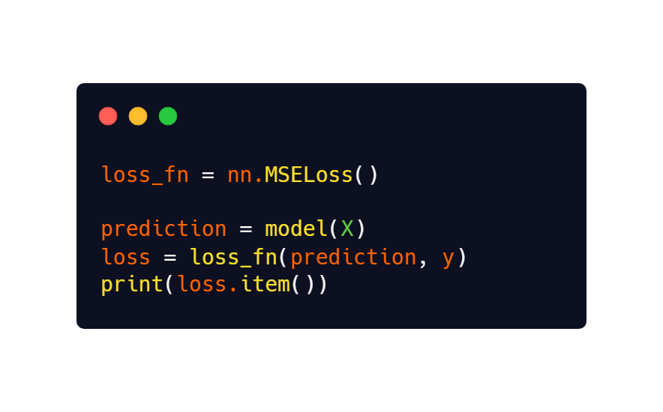
10 | LOSS FUNCTION
Loss: Measure How Wrong the Prediction Is
For regression, Mean Squared Error (MSE) gives one number that summarizes the prediction error.
MEAN SQUARED ERROR
MSE in plain language
• 1. Difference: prediction − real value.
• 2. Square it: large mistakes count more.
• 3. Average: combine all sample errors into one loss value.
Tiny example: predicted 70, actual 76
70
70 − 76 = −6
(−6)² = 36
Prediction
Difference
Square
Goal
Training tries to make the loss smaller, not simply to “increase accuracy.”
JRCAI | Joint Research Center for AI (SDAIA - KFUPM) • PyTorch Fundamentals
11 / 18

Slide 12
11 | COMPUTATIONAL GRAPH
Computational Graph: PyTorch Remembers the Math
During the forward pass, PyTorch records how tensors and model parameters were used to produce the loss.
SIMPLE IDEA
A graph is a map of the calculation
• Node: a tensor or mathematical operation.
• Connection: shows how one result depends on another.
• Why it matters: PyTorch can follow this map backward to calculate gradients.
• Dynamic: the graph is created from the operations that run in Python.
Forward pass builds the dependency path
X
Linear
ReLU
Linear
Prediction
Loss
backward() follows it in reverse
Do we draw this graph ourselves?
No. PyTorch creates it automatically while tensor operations run.
JRCAI | Joint Research Center for AI (SDAIA - KFUPM) • PyTorch Fundamentals
12 / 18

Slide 13
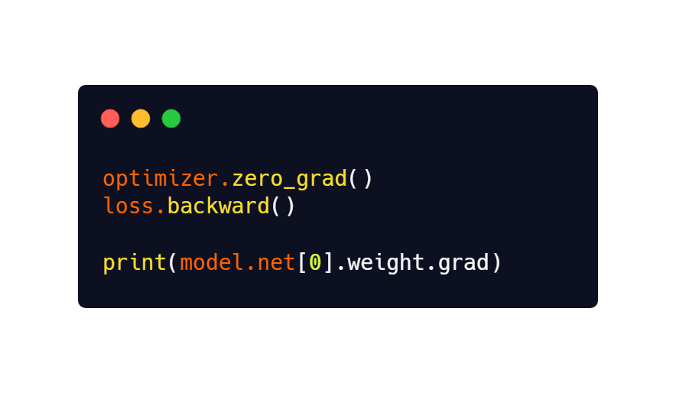
12 | AUTOGRAD
Autograd: Calculate Gradients Automatically
A gradient tells us how the loss would change if a model parameter changed slightly.
A simple downhill analogy
GRADIENT
Think of it as a direction signal
• Positive / negative: which direction would increase or decrease the loss.
• Size: how sensitive the loss is to that parameter.
The gradient points to how the loss changes. The optimizer uses that information to choose an update.
Key distinction
Autograd calculates gradients. It does not update the weights.
JRCAI | Joint Research Center for AI (SDAIA - KFUPM) • PyTorch Fundamentals
13 / 18

Slide 14
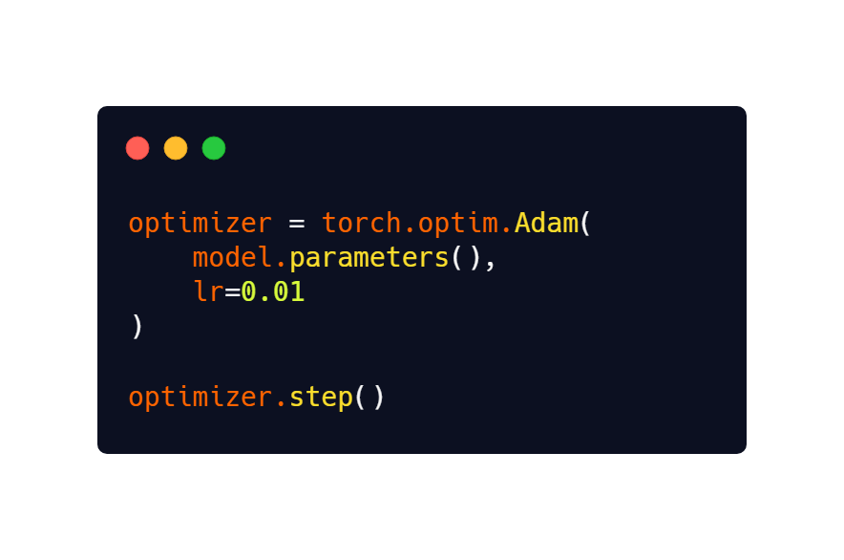
13 | OPTIMIZATION
Optimizer: Use Gradients to Update the Weights
The optimizer changes the model parameters so the next prediction can produce a smaller loss.
Who does what?
LOSS
How wrong?
AUTOGRAD
Which direction?
LEARNING RATE
What does lr mean?
• Learning rate: the step size used when changing model parameters.
• Too large / too small: can make learning unstable or unnecessarily slow.
OPTIMIZER
Change weights
In our example
We use Adam, a common adaptive optimizer.
JRCAI | Joint Research Center for AI (SDAIA - KFUPM) • PyTorch Fundamentals
14 / 18

Slide 15
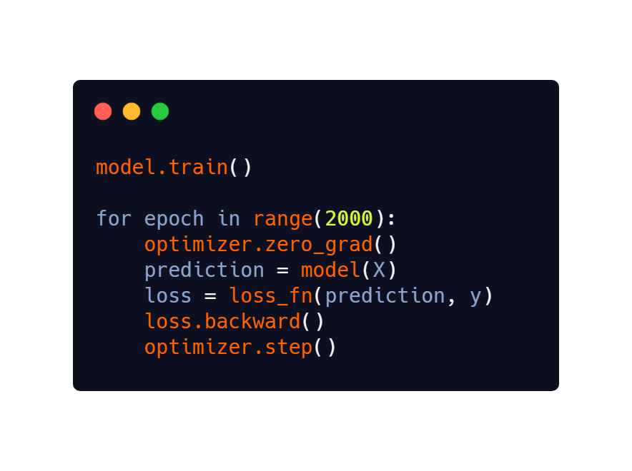
14 | TRAINING LOOP
Training Loop: Repeat the Learning Cycle
Training is the same few operations repeated many times: predict, measure error, calculate gradients, update weights.
1
Predict
5
2
Repeat
Loss
4
3
Update
Backward
The training loop repeatedly predicts, measures the error, calculates gradients, and updates the model’s weights. Each repetition helps the model learn and reduce its loss.
Epoch
One epoch means one full pass through the training data.
JRCAI | Joint Research Center for AI (SDAIA - KFUPM) • PyTorch Fundamentals
15 / 18

Slide 16
15 | LEARNING PROGRESS
Loss Curve: Is the Model Learning?
If training is working, the loss should generally decrease as the optimizer improves the model parameters.
WHAT THE GRAPH SHOWS
The model is reducing its error
• Start: predictions are poor, so loss is high.
• Later: updates make predictions closer to the targets.
IMPORTANT
Low training loss is not everything
• Real projects: also evaluate on unseen validation/test data to check generalization.
Chart data
Shown as % of the starting loss for readability.
Epoch →
JRCAI | Joint Research Center for AI (SDAIA - KFUPM) • PyTorch Fundamentals
16 / 18

Slide 17
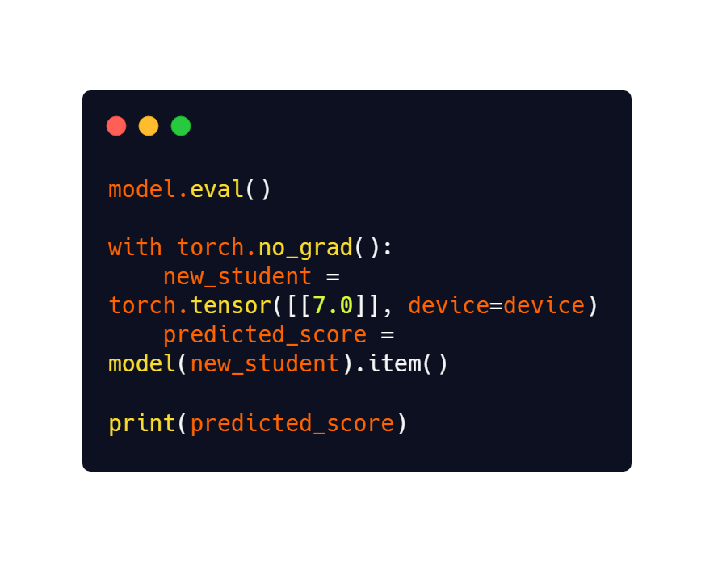
16 | INFERENCE
Inference: Use the Trained Model on New Data
After training, we stop updating weights and ask the model to make predictions on data it did not train on.
MODEL.EVAL()
Switch to evaluation behavior
• What it does: changes layers such as Dropout and BatchNorm to evaluation mode.
• What it does NOT do: it does not itself disable gradient tracking.
TORCH.NO_GRAD()
Stop recording gradients
• Why: inference does not need backpropagation, so this reduces unnecessary work and memory use.
7 study hours
≈ 91.7 score
JRCAI | Joint Research Center for AI (SDAIA - KFUPM) • PyTorch Fundamentals
17 / 18

Slide 18
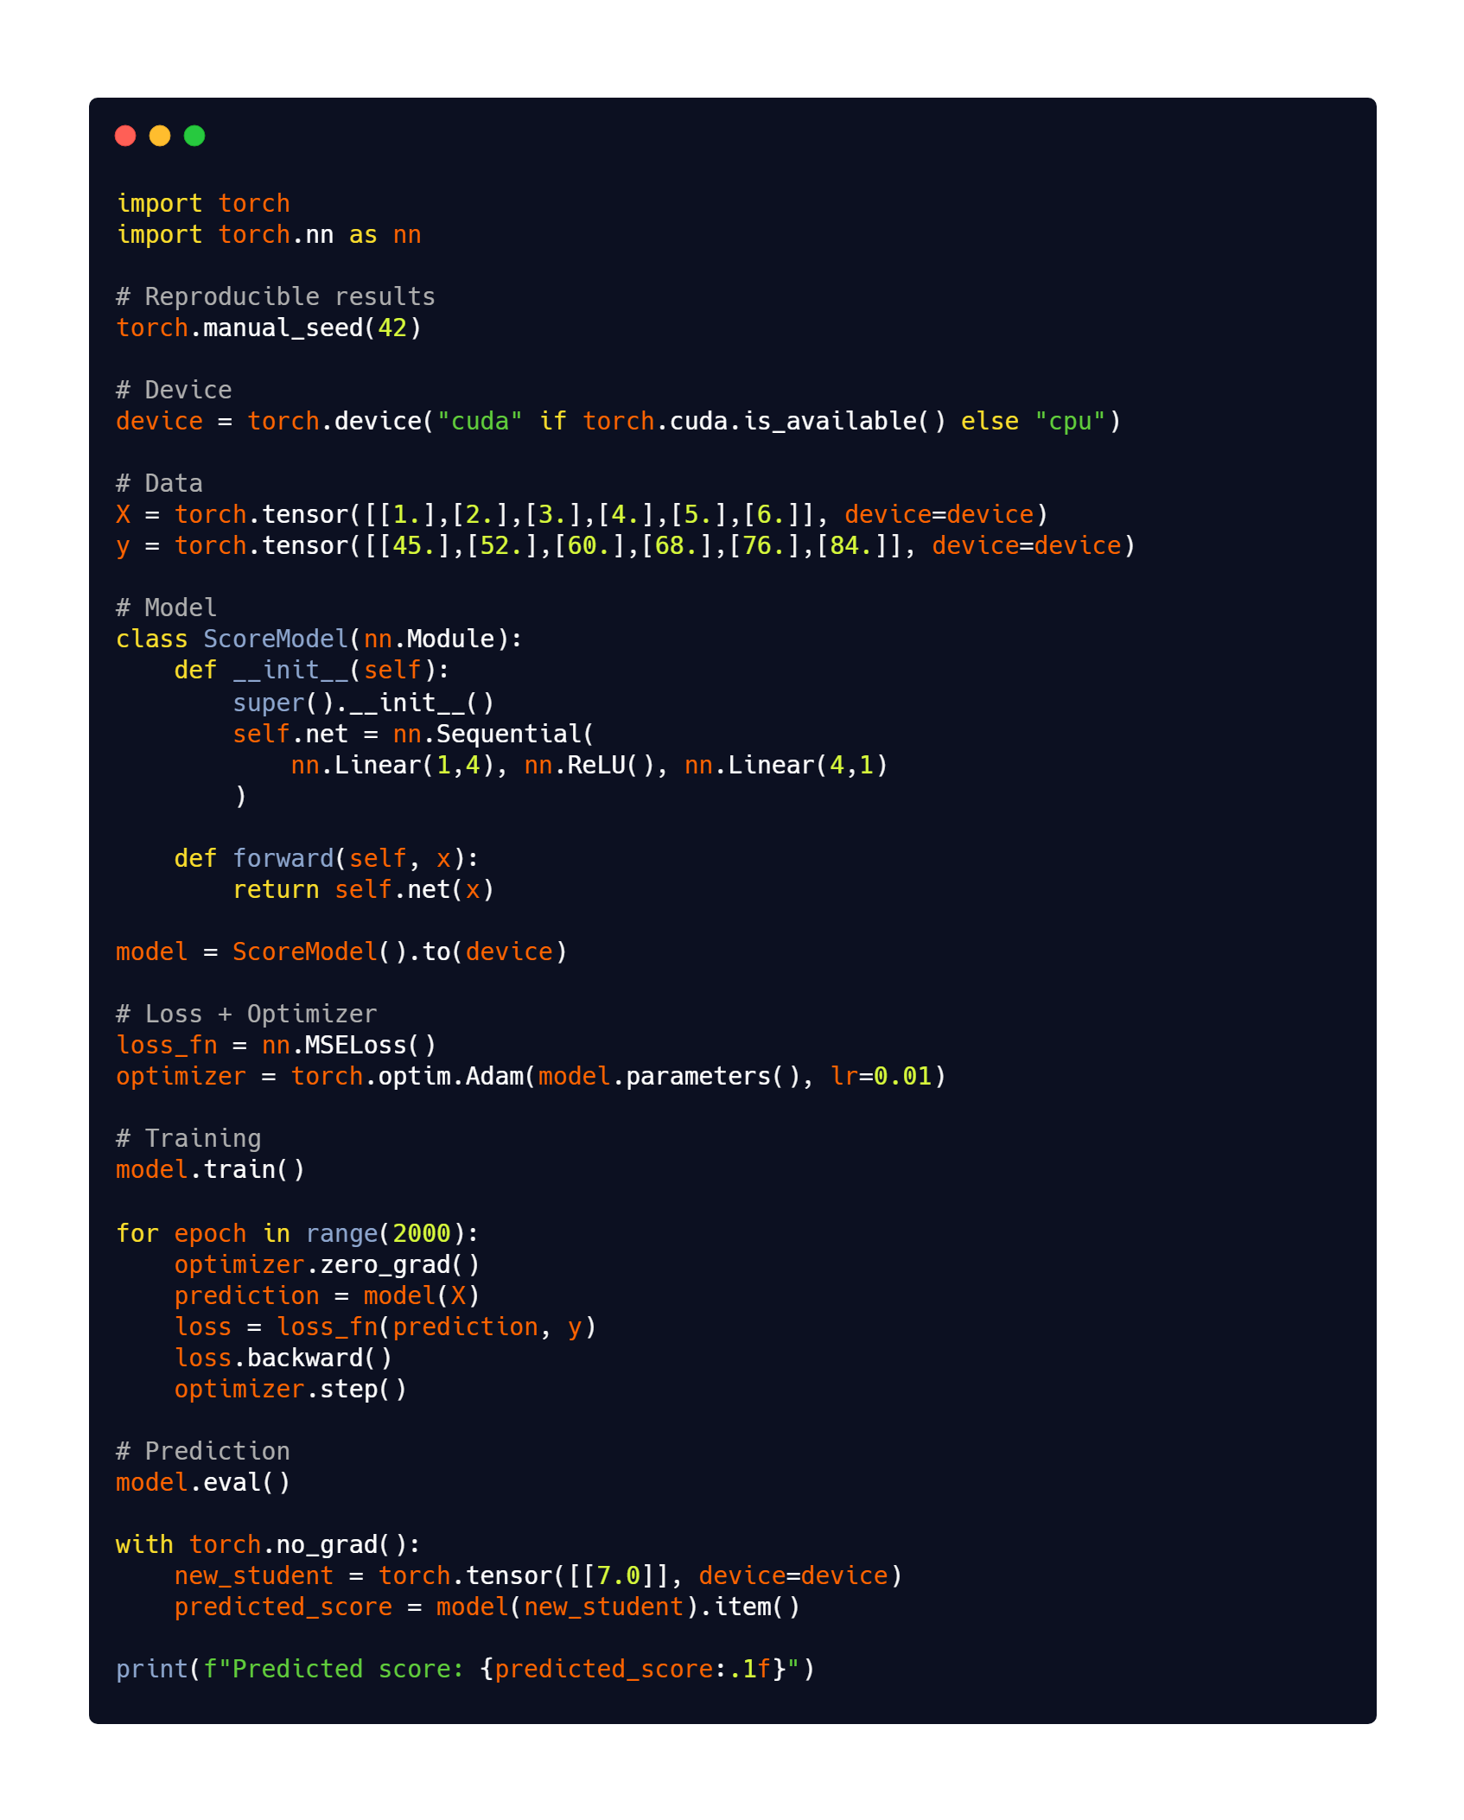
17 | PUTTING IT ALL TOGETHER
The Complete PyTorch Example
Every line below is a piece we already explained: data → model → loss → backward → optimizer → prediction.
DATA
MODEL
LOSS / OPTIMIZE
TRAIN
PREDICT
JRCAI | Joint Research Center for AI (SDAIA - KFUPM) • PyTorch Fundamentals
18 / 18

Slide 19
Thank You!
PREPARED BY
Ahmed Saleh Almutairi
PRESENTED TO
Dr. Safwan Alselwi

